Slide 1
CENG 241 Scientific Computing

Slide 2
Course Resources
www.mathworks.com
Higham & Higham, MATLAB GUIDE, SIAM Pubs

Slide 3
What is MATLAB?
Data processing and visualization tools
Easy, fast manipulation and processing of complex data
Visualization to aid data interpretation
Production of publication quality figures
High-level programming languages
Can write extensive programs, applications,…
Faster code development than with C, Fortran, etc.
Possible to “play” with or “explore” data – don’t have to write a standalone program to do a predetermined job

Slide 5
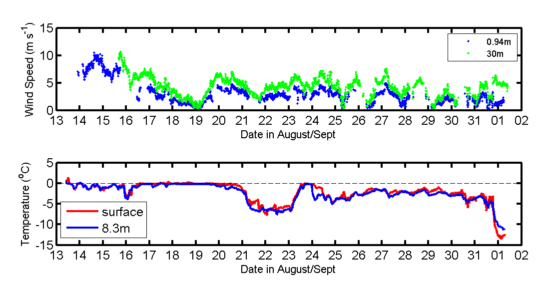
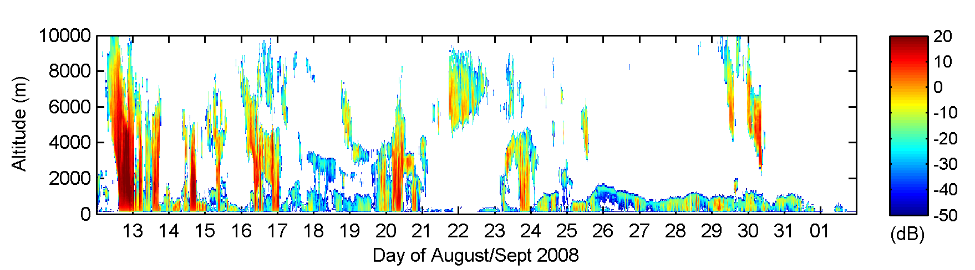

Slide 6
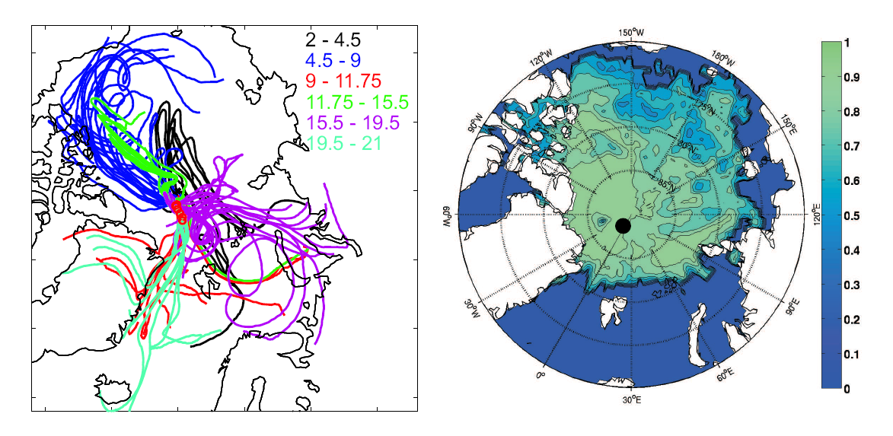

Slide 7
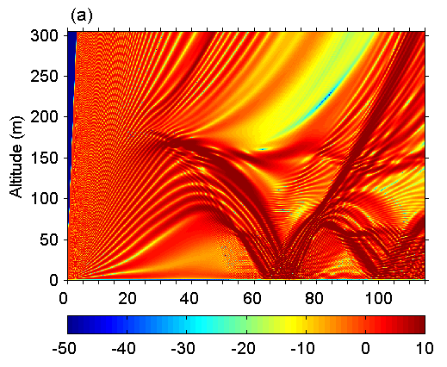
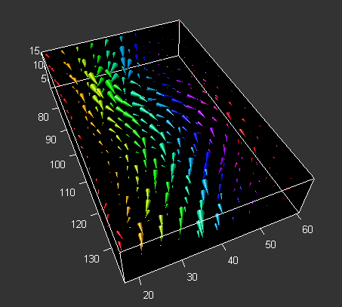

Slide 8
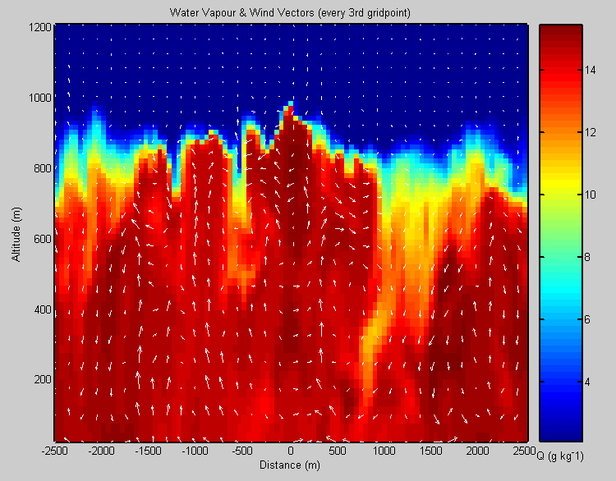

Slide 9
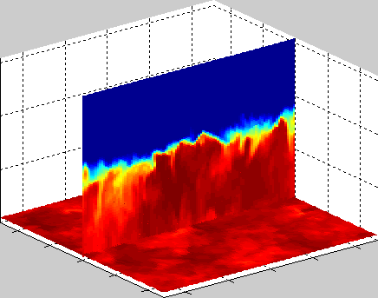

Slide 10
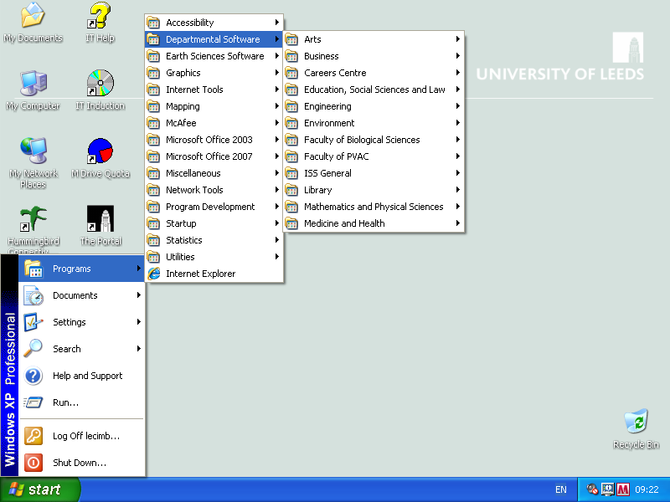
Getting Started: Windows

Slide 11
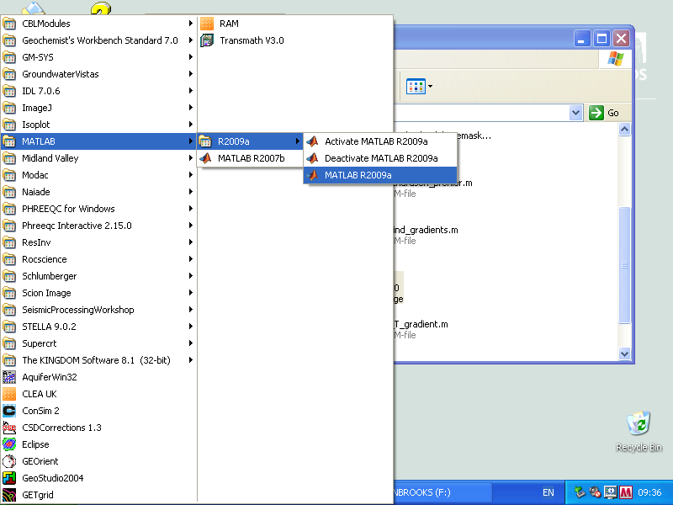

Slide 12
Getting started – linux (SEE)
Just enter ‘matlab’ or ‘matlab &’ on the command line
Might need to run ‘app setup matlab’ or add this to your .cshrc file

Slide 13
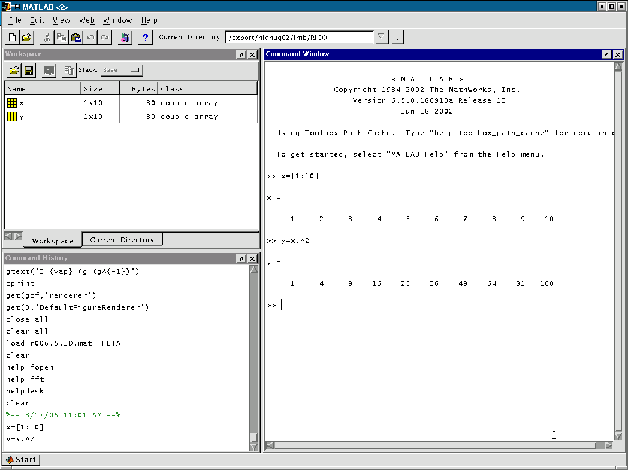
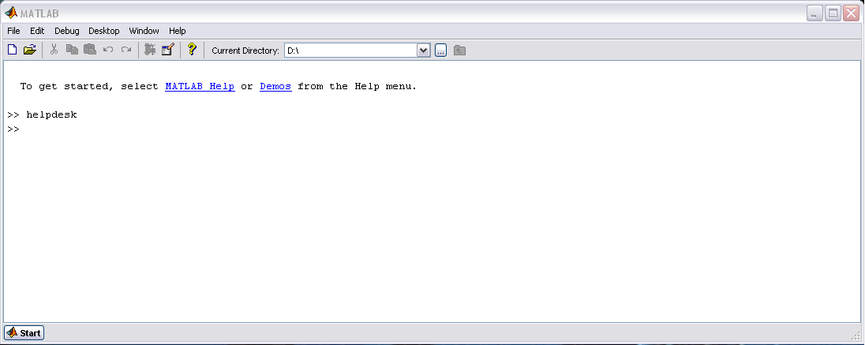
MATLAB User Environment
Workspace/Variable
Inspector
Command Window
Command History

Slide 14
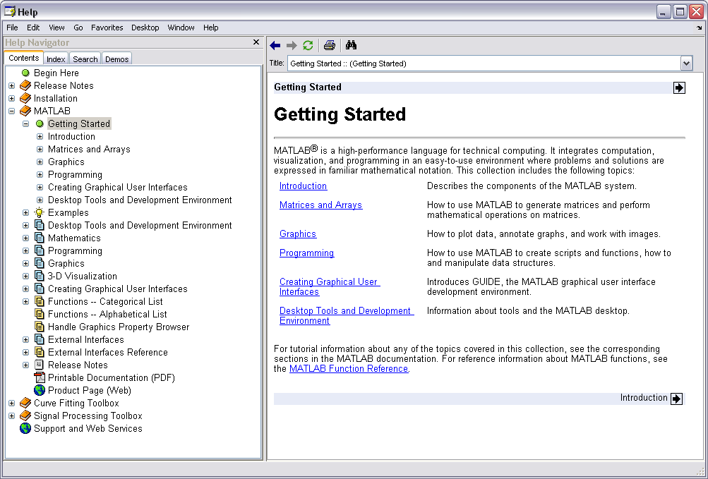
Getting help
There are several ways of getting help:
Basic help on named commands/functions is echoed to the command window by:
>> help command-name
A complete help system containing full text of manuals is started by:
>> helpdesk

Slide 15
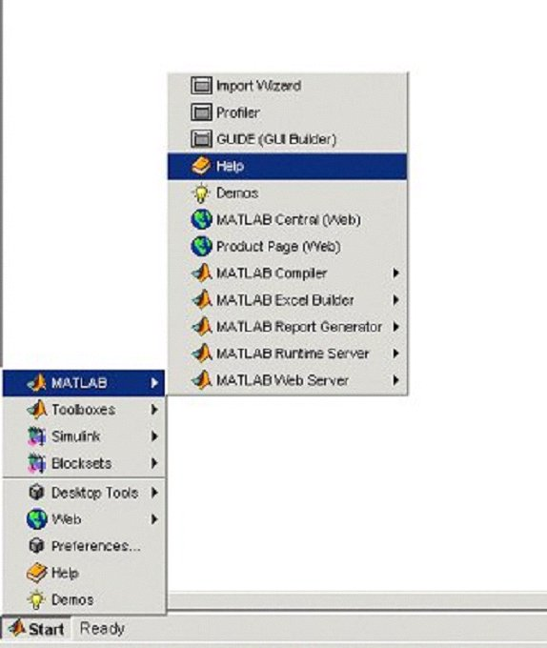
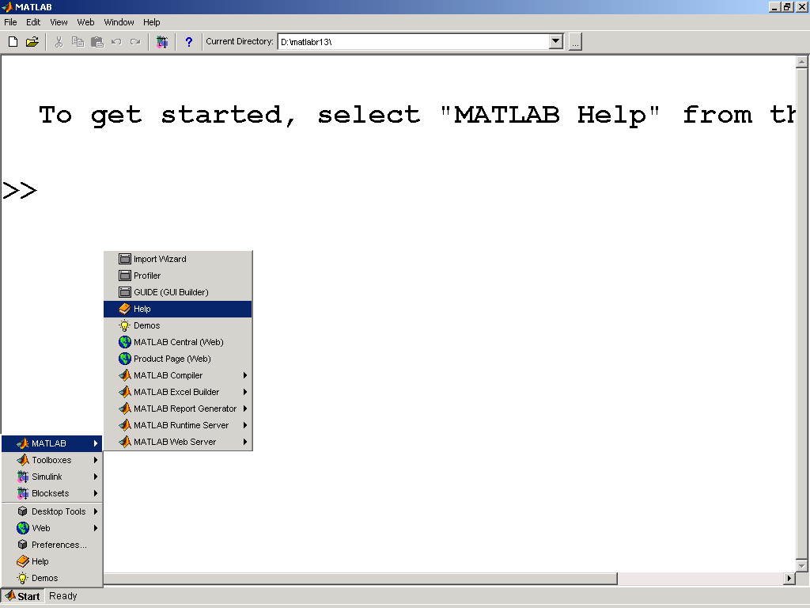
Accessing the Help Browser via the Start Menu
Notes:
Accessing the Help Browser via the Start Menu
You can open the Help Browser from the MATLAB Start Button, shown in the lower left hand corner of the MATLAB Desktop. Open the MATLAB Help Browser by selecting Start→MATLAB→Help.
You can also open the Help Browser by typing of the following commands from your MATLAB command line:
>> helpbrowser
In the Start Menu there is a list of all of the products that you have access to for your particular MATLAB licence. When you select a product, options related to that product open.

Slide 16
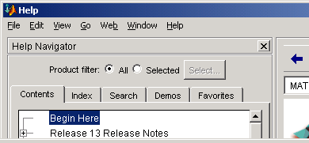
Help Browser
Contents
Search
Index
Demos
Contents - browse through topics in an expandable "tree view"
Index - find topics using keywords
Search - search the documentation. There are four search types available:
Full Text - perform a full-text search of the documentation
Document Titles - search for word(s) in documentation section titles
Function Name - see reference descriptions of functions
Online Knowledge Base - search the Technical Support Knowledge
Base
Demos – view and run product demos
Notes:
Help Browser
The Help Browser contains information on the products
that you have a licence to use. Each product has a Roadmap page. On the Roadmap page, you can access information regarding documentation on the selected product, finding functions, and printing the documentation.
You can access the most powerful features of the Help
browser through the tabs in the Help Navigator.
Contents: browse through topics in an expandable “ tree view ”
Index: find topics using keywords
Search: search the documentation. There are four search types
available:
Full Text: perform a full-text search of the documentation
Document Titles: search for word(s) in documentation
section titles
Function Name: see reference descriptions of functions
Online Knowledge Base: search the Technical Support Knowledge Base
Demos: view and run product demos

Slide 17
Other sources of help
www.mathworks.com
Help forums, archived questions & answers, archive of user-submitted code
http://lists.leeds.ac.uk/mailman/listinfo/see-matlab
Mailing list for School of Earth & Environment self-help from other users within the school (31 at last count)

Slide 18
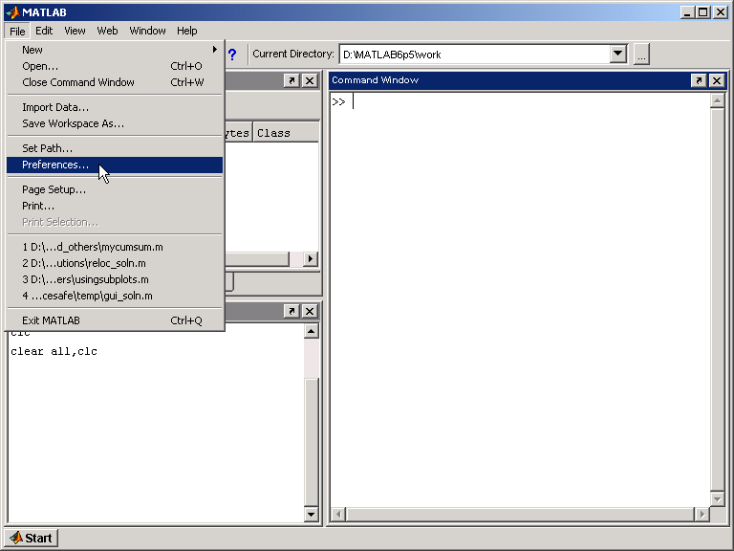
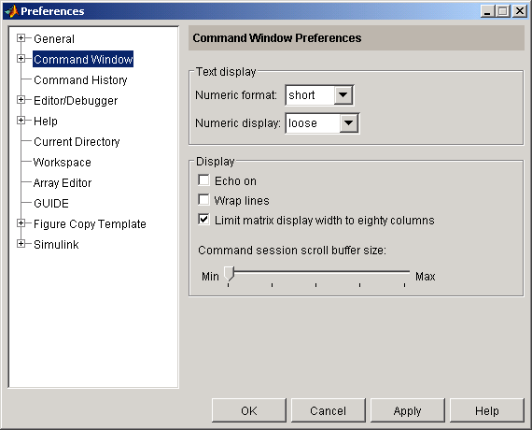
Modifying the MATLAB Desktop Appearance
Notes:
Modifying the MATLAB Desktop Appearance
There are many ways of modifying the look and feel of your MATLAB Desktop windows. For example, by using the Preferences window, you can change properties such as
the colour and font size of your MATLAB Desktop. To access the Preferences window, select File→Preferences.
The tree window on the left-hand side shows the objects that can be customized:
General - affects the whole desktop
Command Window
Command History
Editor/Debugger
Help
Current Directory
Workspace
Array Editor
GUIDE: Graphical User Interface Design Environment
Figure Copy Template
Note
Simulink options are available only if you
have licensed the Simulink product.

Slide 19
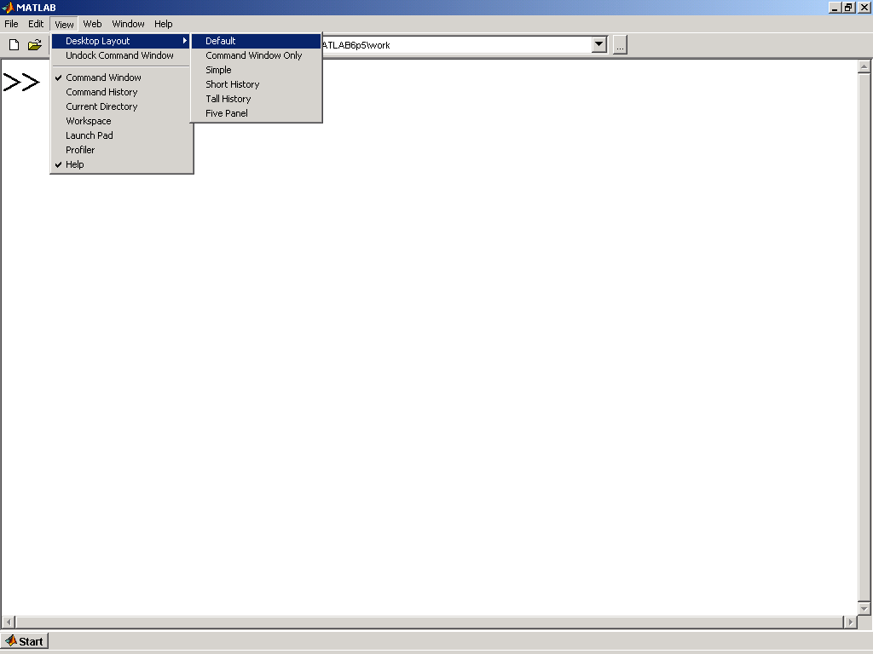
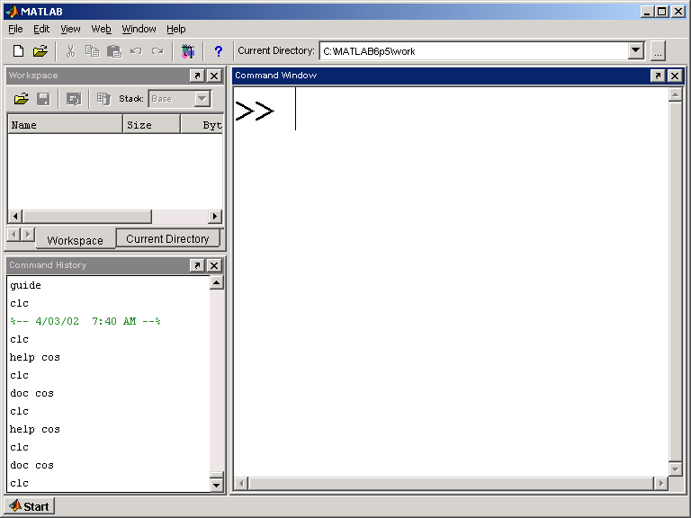
Returning to the Default MATLAB Desktop
Notes:
Returning to the Default MATLAB Desktop
The figure shows the default appearance of the MATLAB Desktop. To use the default settings in the Command Window select Desktop→Desktop Layout→Default. There are three windows on this desktop. The properties of these windows and the content of these windows are described on the following pages.

Slide 20
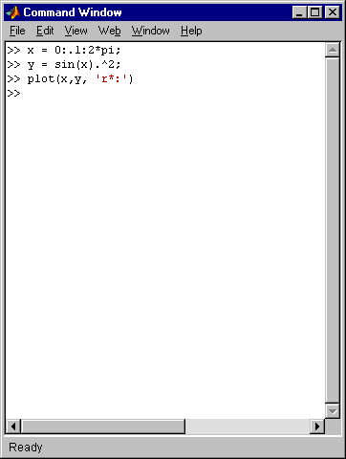
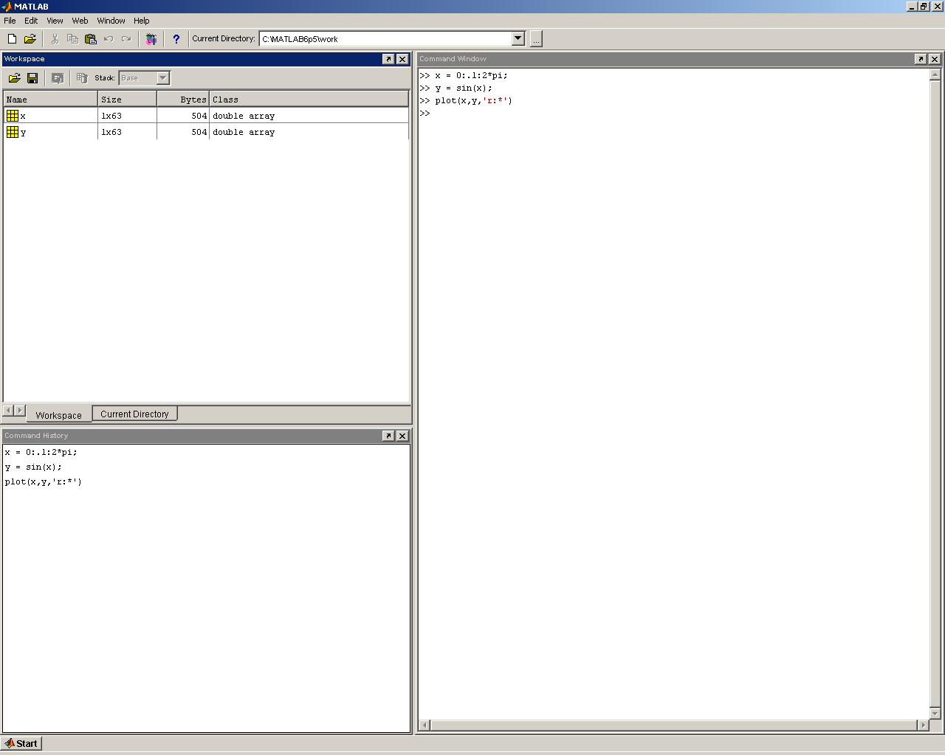
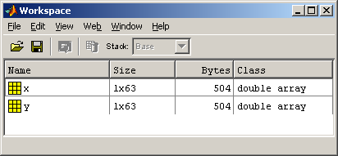
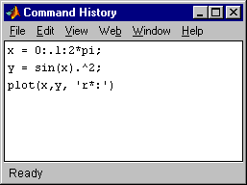
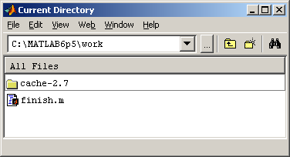
The Contents of the MATLAB Desktop
Notes:
The Contents of the MATLAB Desktop
The MATLAB Desktop allows you to launch a number of different MATLAB utilities, which are:
Workspace browser
Command History window
Current Directory window
The Workspace browser allows you to view all the variables in the current workspace.
The Command History window lists the commands that have been entered in previously. These commands can be selected and executed from within this window (right-click on the selection).
The Current Directory window lets you see the content of the current directory. The content includes files and subdirectories.

Slide 21
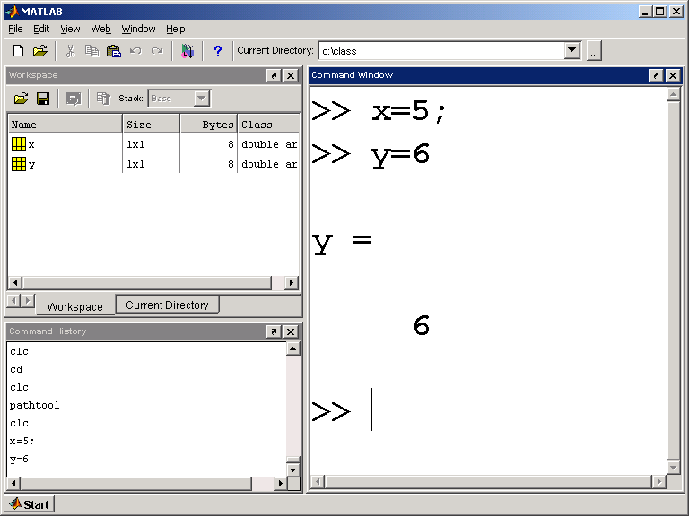
Workspace Browser
Notes:
Workspace Browser
The Workspace Browser allows you to look at variables that have been created in the MATLAB workspace.
Note the example below.

Slide 22
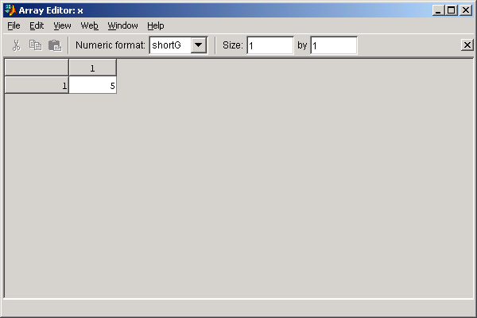
Array Editor
For editing 2-D numeric arrays
double-click
Notes:
Array Editor
You can open and edit the contents of 2-D numeric and string arrays using the Array Editor. You can view the contents of cell arrays and structures, two data types that are discussed later in this section. There are two ways to access the Array Editor:
Double-click on the yellow box in the Workspace Browser next to the variable name.
Use the openvar command with the variable name from the MATLAB command line.
Using the Array Editor of MATLAB 6.5 you can view large arrays of up to 65535 elements.
Sections of an array in the Array Editor can be changed or copied. Right-clicking on a selection within the Array Editor allows you to:
Cut, copy, and paste information to and from the clipboard
Insert or delete rows and columns (when possible)
Clear contents of cells (change values to zero)
Note The clipboard capability of the Array Editor is compatible with other programs such as Excel. This means that array information can be freely copied from Excel into MATLAB, and from MATLAB into Excel.

Slide 23
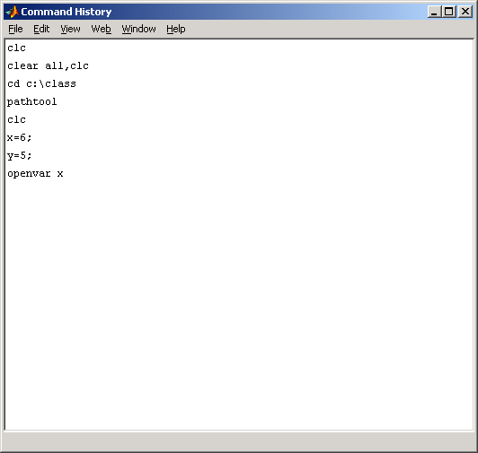
Command History Window
Notes:
Command History Window
During a MATLAB session all of the commands you type and enter from the command line are saved in the Command History window.
You can right-click on any line and see a shortcut menu with the following options:
Copy Copies selected item(s)
Evaluate Selection Runs the selected code
Create M-File Places the selected code in the M-file Editor/Debugger
Delete Selection Deletes one selected line of code
Delete to Selection Deletes a selected segment of code (multiple lines)
Delete Entire History Deletes the entire history that has been stored in this window.

Slide 24
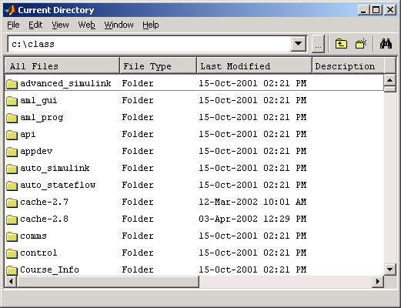
Current Directory Window
Notes:
Current Directory Window
The Current Directory window displays the files in the current directory and allows you to open and load files by double clicking on them.
You can also change directories, find references to file names, and add a subfolder or subdirectory to this current directory.

Slide 26
Calculations on the command Line
MATLAB as a calculator
Assigning Variables
>> -5/(4.8+5.32)^2
ans =
-0.048821
>> (3+4i)*(3-4i)
ans =
25
>> cos(pi/2)
ans =
6.1232e-017
>> exp(acos(0.3))
ans =
3.547
>> a = 2;
>> A = 5;
>> a^A
ans =
32
>> x = 5/2*pi;
>> y = sin(x)
y =
1
>> z = asin(y)
z =
1.5708
Semicolon suppresses screen output
Variables are case
sensitive
Results assigned to “ans” if name not given
Use parentheses ( ) for function inputs
Numbers stored in double-precision floating point format

Slide 27
The WORKSPACE
MATLAB maintains an active workspace, any variables (data) loaded or defined here are always available.
Some commands to examine workspace, move around, etc:
who : lists the variables defined in workspace
>> who
Your variables are:
x y

Slide 28
whos : lists names and basic properties of variables in the workspace
>> whos
Name Size Bytes Class
x 3x1 24 double array
y 3x2 48 double array
Grand total is 9 elements using 72 bytes

Slide 29
Entering Numeric Arrays
Row separator:
Semicolon (;) or newline
Column separator:
space or comma (,)
>> a=[1 2;3 4]
a =
1 2
3 4
>> b = [2:-0.5:0]
b =
2 1.5 1 0.5 0
>> c = rand(2,4)
c =
0.9501 0.6068 0.8913 0.4565
0.2311 0.4860 0.7621 0.0185
Use square brackets [ ]
Creating sequences using the colon operator (:)
Utility function for creating matrices.
Matrices must
be rectangular. (Undefined elements set to zero)
Notes:
Square brackets, Semi colon and comma
Colon operator – default step size is 1
Matrix utilities: rand, randn, zeros, ones, eye, diag
Entering Numeric Arrays
Remember that each type of bracket has a specific meaning in MATLAB
Square Braces
The easiest way to enter small matrices is to enter explicit
lists inside square brackets.
>> a = [1, 2; 3, 4]
a =
1 2
3 4
A comma or space indicates a separate entry in the same row. A semicolon indicates the end of a row.
Use of Colons
Numeric sequences can be easily created by use of the colon. This operator creates linearly spaced, monotonic (increasing or decreasing) vectors of numbers. If no step size is specified, a step size of 1 is assumed. The colon is used with the syntax
sequence = min:step_size:max
>> b = 2:-0.5:0
b =
2.0000 1.5000 1.0000 0.5000 0
Utility Functions
For a list of functions for creating specialized matrices, see the “Utility Commands” reference pages at the end of this section.
>> c = rand(2,4)
Loading MAT-Files
If a MAT-file (MATLAB binary data file) exists, variables can be loaded from the file using the load command. This will load all the variables stored in a particular MAT-file.
>> a=[1 2;3 4]
>> b = 2:-0.5:0
>> c = rand(2,4)

Slide 30
Entering Numeric Arrays (Continued)
Using other MATLAB expressions
>> w = [-2.8, sqrt(-7), (3+5+6)*3/4]
w =
-2.8 0 + 2.6458i 10.5
>> m(3,2) = 3.5
m =
0 0
0 0
0 3.5
>> w(2,5) = 23
w =
-2.8 0 + 2.6458i 10.5 0 0
0 0 0 0 23
Matrix element assignment
Adding to an existing array
Note: MATLAB deals with Imaginary numbers…
Notes:
Entering Numeric Arrays (Continued)
Matrix elements can be any MATLAB expression. For example:
>> w = [-2.8 sqrt(-7) (3+5+6)*3/4]
w =
-2.8000 0 + 2.6458i 10.5000
Note that the size of m is automatically increased to accommodate the new element and the undefined intervening elements are set to zero. See the example below:
>> m(3,2) = 3.5
m =
0 0
0 0
0 3.5
Individual matrix elements can be referenced using indices inside parentheses ( ). Continuing the previous example with the variable w:
>> w(2,5) = 23
w =
-2.8000 0 + 2.6458i 10.5000 0 0
0 0 0 0 23.0000
>> w = [-2.8, ...
sqrt(-7), ...
(3+5+6)*3/4]
>> m(3,2) = 3.5
>> w(2,5) = 23

Slide 31
Indexing into a Matrix in MATLAB
Columns
(n)
1 2 3 4 5
A =
4
1 6 11 16 21
2 7 12 17 22
3 8 13 18 23
4 9 14 19 24
5 10 15 20 25
10
1
6
2
A (2,4)
1
2
Rows (m) 3
4
5
8
1.2
9
4
25
7.2
5
7
1
11
A (17)
0
0.5
4
5
56
Rectangular Matrix:
Scalar: 1-by-1 array
Vector: m-by-1 array
1-by-n array
Matrix: m-by-n array
23
83
13
0
10
Notes:
Indexing into a Matrix in
MATLAB
There are two different ways of indexing into a matrix in MATLAB:
Using the (row, column) form
Using single subscript index
Row Column
The indices in MATLAB start from the top left corner of the matrix with the initial index of 1.
To access the value of 4 in A, you can specify the row and column values as two separate values inside parentheses.
>> A(2,4)
Single Subscript Index
MATLAB was originally written in Fortran, which is a column major language. Even though the MATLAB code is now written in C, this property still remains. This means that the single subscript indices of a matrix go from top to bottom, and then left to right, starting with the value of 1.
The single subscript index form for extracting the 4 from A would be as follows.
>> A(17)

Slide 32
Array Subscripting / Indexing
1 2 3 4 5
A =
4
1 6 11 16 21
2 7 12 17 22
3 8 13 18 23
4 9 14 19 24
5 10 15 20 25
10
1
6
2
1
2
3
4
5
8
1.2
9
4
25
A(1:5,5)
A(:,5)
A(21:25)
A(1:end,end)
A(:,end)
A(21:end)’
7.2
5
7
1
11
A(3,1)
A(3)
0
0.5
4
5
56
23
83
13
0
10
A(4:5,2:3)
A([9 14;10 15])
Use () parentheses to specify index
colon operator (:) specifies range / ALL
[ ] to create matrix of index subscripts
'end' specifies maximum index value
Notes:
Array Subscripting / Indexing
Recall that the two basic ways arrays can be indexed are
(Row, column) indexing
Single Subscript indexing
Indices must always be integers and can refer to
A single element
A continuous range of elements (use colon operator to create sequence – min:step:max)
A randomly assorted list of elements
The shape of the resulting matrix is generally the same as the matrix used to index.
The following commands are also useful for subscripting:
find Returns index/subscript values for elements that satisfy a given condition
ind2sub Converts linear-index (single subscript index) values to row-column subscript values
sub2ind Converts row-column subscript values to linear-index (single subscript index) values
>> first_mat
>> A([1, 7, 2;
3, 6, 2])

Slide 33
THE COLON OPERATOR
Colon operator occurs in several forms
To indicate a range (as above)
To indicate a range with non-unit increment
>> N = 5:10:35
N =
5 15 25 35
>> P = [1:3; 30:-10:10]
P =
1 2 3
30 20 10

Slide 34
To extract ALL the elements of an array (extracts everything to a single column vector)
>> A = [1:3; 10:10:30;
100:100:300]
A =
1 2 3
10 20 30
100 200 300
>> A(:)
ans =
1
10
100
2
20
200
3
30
300

Slide 35
Numerical Array Concatenation [ ]
Use [ ] to combine existing arrays as matrix “elements”
>> a=[1 2;3 4]
a =
1 2
3 4
>> cat_a=[a, 2*a; 3*a, 4*a; 5*a, 6*a]
cat_a =
1 2 2 4
3 4 6 8
3 6 4 8
9 12 12 16
5 10 6 12
15 20 18 24
Use square brackets [ ]
Row separator:
semicolon (;)
Column separator:
space / comma (,)
4*a
N.B. Matrices MUST
be rectangular.
Notes:
Numerical Array Concatenation – []
You can join matrices using square brackets, which is the array concatenation operator. A space / comma is used to separate columns, while a semicolon is used to separate rows within the brackets.
>> a=[1 2;3 4]
a =
1 2
3 4
>> cat_a=[a, 2*a; 3*a, 4*a; 5*a, 6*a]
cat_a =
1 2 2 4
3 4 6 8
3 6 4 8
9 12 12 16
5 10 6 12
15 20 18 24
>> a=[1 2;3 4]
>> cat_a=[a, 2*a;
3*a, 4*a;
5*a, 6*a]
4*a

Slide 36
Matrix and Array Operators
Matrix Operators
Array operators
()
parentheses
Common Matrix Functions
'
complex conjugate
transpose
.'
array transpose
inv
matrix inverse
det
determinant
^
power
.^
array power
rank
matrix rank
*
multiplication
.*
array
mult.
eig
eigenvectors and
eigenvalues
/
division
./
array division
svd
singular value dec.
\
left division
norm
matrix / vector norm
+
addition
-
subtraction
>> help ops
>> help matfun
Notes:
Matrix and Array Operators
Below you see the basic math operations used in MATLAB
(in order of precedence).
Here are some of the commonly used matrix functions in MATLAB.
inv Matrix inverse
det Determinant
rank Matrix rank
eig eigenvectors and eigenvalues
svd Singular value decomposition
norm Matrix/vector norm
Matrix and array operators perform mathematical calculations on
matrices and arrays, respectively. Visually matrices and arrays look the same. The key difference between matrix and array operators is based on how you want the operators to work with the matrices or arrays. For example, if you want to perform matrix multiplication you would use this asterisk symbol (*). However, if you specifically want to perform array multiplication you need to use a dot with an asterisk (.*). The differences between how matrix versus array multiplication are performed is discussed further in this section.
Matrix Operators
Array Operators
() parentheses
’
complex conjugate
transpose
.’ array transpose
^ power
.^ array power
* multiplication
.* array
mult.
/ division
./ array division
\ left division
+ addition
- subtraction

Slide 37
1 & 2D arrays are treated as formal matrices
Matrix algebra works by default:
>> a=[1 2];
>> b=[3
4];
>> a*b
ans =
11
>> b*a
ans =
3 6
4 8
1x2 row oriented array (vector) (Trailing semicolon suppresses display of output)
2x1 column oriented array
Result of matrix multiplication depends on order of terms (non-cummutative)

Slide 38
Element-by-element (array) operation is forced by preceding operator with a period ‘.’
>> a=[1 2];
>> b=[3
4];
>> c=[3 4];
>> a.*b
??? Error using ==> times
Matrix dimensions must agree.
>> a.*c
ans =
3 8
Size and shape must match

Slide 39
Matrix Calculation-Scalar Expansion
>> w=[1 2;3 4] + 5
w =
6 7
8 9
>> w=[1 2;3 4] + 5
1 2
= + 5
3 4
1 2 5 5
= +
3 4 5 5
6 7
=
8 9
Scalar expansion
Notes:
Matrix Calculation - Scalar Expansion
Normally matrix addition or subtraction requires that the matrices have the same dimensions. However, MATLAB allows the addition, subtraction, multiplication, and division of scalars to matrices of any size (known as scalar expansion). The scalar’s size is increased to match the matrix to which it is being added / subtracted.
>> w=[1 2;3 4] + 5

Slide 40
Matrix Multiplication
Inner dimensions must be equal.
Dimension of resulting matrix = outermost dimensions of multiplied matrices.
Resulting elements = dot product of the rows of the 1st matrix with the columns of the 2nd matrix.
>> a = [1 2 3;4 5 6];
>> b = [3,1;2,4;-1,2];
>> c = a*b
c =
4 15
16 36
[2x3]
[3x2]
[2x3]*[3x2] [2x2]
a(2nd row).b(2nd column)
Notes:
Matrix Multiplication
When performing matrix multiplication, these rules apply:
Inner dimensions must be equal.
Dimension of resulting matrix are outermost dimensions of multiplied matrices.
Resulting elements are the dot product of the rows of the first matrix with the columns of the second matrix.
>> a = [1 2 3;4 5 6];
>> b = [3,1;2,4;-1,2];
>> c = a*b
c =
4 15
16 36
>> a = [1 2 3;
4 5 6];
>> b = [3,1;2,4;
-1,2];
>> c = a*b

Slide 41
Array (element-by-element) Multiplication
Matrices must have the same dimensions (size and shape)
Dimensions of resulting matrix = dimensions of multiplied matrices
Resulting elements = product of corresponding elements from the original matrices
Same rules apply for other array operations
>> a = [1 2 3 4; 5 6 7 8];
>> b = [1:4; 1:4];
>> c = a.*b
c =
1 4 9 16
5 12 21 32
c(2,4) = a(2,4)*b(2,4)
Notes:
Array Multiplication
When using array multiplication (.*), the following rules apply:
Matrices must have the same dimensions (or one of them should be a scalar).
Dimensions of resulting matrix are the dimensions of multiplied matrices.
Resulting elements are the product of corresponding elements from the original matrices.
>> a = [1 2 3 4;
5 6 7 8];
>> b = [1:4;
1:4];
>> c = a.*b

Slide 42
>> a=[1 2]
A =
1 2
>> b=[3 4];
>> a.*b
ans =
3 8
>> c=a+b
c =
4 6
No trailing semicolon, immediate display of result
Element-by-element multiplication
Matrix addition & subtraction operate element-by-element anyway. Dimensions of matrix must still match!

Slide 43
>> A = [1:3;4:6;7:9]
A =
1 2 3
4 5 6
7 8 9
>> mean(A)
ans =
4 5 6
>> sum(A)
ans =
12 15 18
>> mean(A(:))
ans =
5
Many common functions operate on columns by default
Mean of each column in A
Mean of all elements in A

Slide 44
Clearing up
>> clear clear all workspace
>> clear VARNAME clear named variable
>> clear all clear everything (see help clear)
>> close all close all figures
>> clc clears command window display only

Slide 45
Boolean (logical) operators
== is equal to
> greater than
< less than
>= greater than or equal to
<= less than or equal to
~ not
& and
| or
isempty() true if matrix is empty, []
isfinite() true where elements are finite
isinf() true where elements are infinite
any() true if any element is non-zero
all() true is all elements are non-zero
zeros([m,n]) - create an m-by-n matrix of zeros
zeros(size(A)) - create a matrix of zeros the same size as A

Slide 46
LOGICAL INDEXING
Instead of indexing arrays directly, a logical mask can be used – an array of same size, but consisting of 1s and 0s (true and false) – usually derived as result of a logical expression.
>> X = [1:10]
X =
1 2 3 4 5 6 7 8 9 10
>> ii = X>6
ii =
0 0 0 0 0 0 1 1 1 1
>> X(ii)
ans =
7 8 9 10

Slide 47
Logical indexing is a very powerful tool for selecting subsets of data. Combine multiple conditions using boolean operators.

Slide 48
>> >> x = [1:10];
>> y = x.^0.5;
>> i1 = x >= 5
I1 =
0 0 0 0 1 1 1 1 1 1
>> i2 = y<3
i2 =
1 1 1 1 1 1 1 1 0 0
>> ii = i1 & i2
ii =
0 0 0 0 1 1 1 1 0 0
>> find(ii)
ans =
5 6 7 8
Find function converts logical index to numeric index

Slide 49
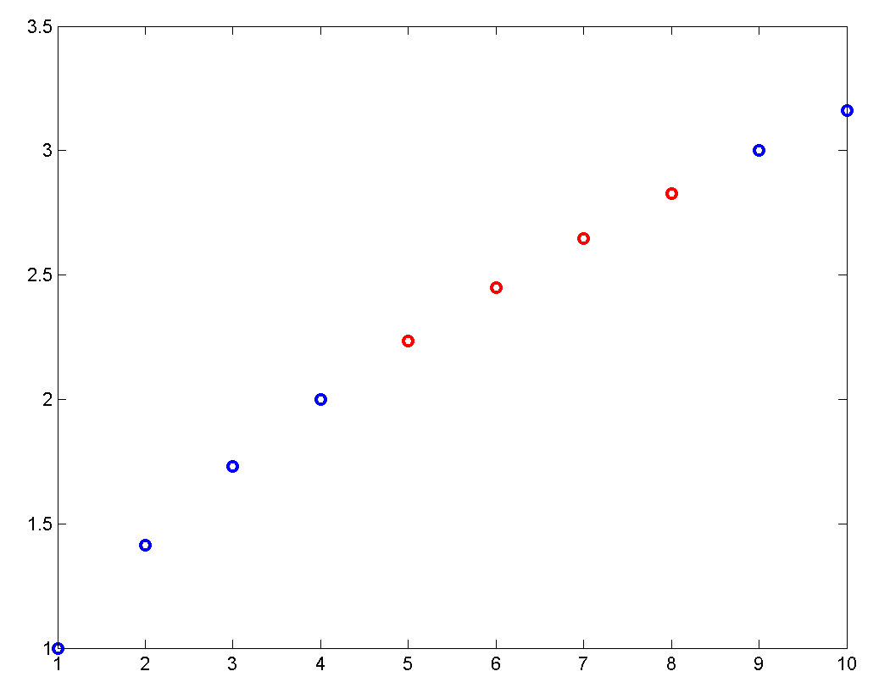
>> plot(x,y,’bo’)
>> plot(x(ii),y(ii),’ro’)

Slide 50
Basic Plotting Commands
figure : creates a new figure window
plot(x) : plots line graph of x vs index number of array
plot(x,y) : plots line graph of x vs y
plot(x,y,'r--') : plots x vs y with linetype specified in string : 'r' = red, 'g'=green, etc for a limited set of basic colours. '−' solid line, '− −' dashed, 'o' circles…see graphics section of helpdesk

Slide 51
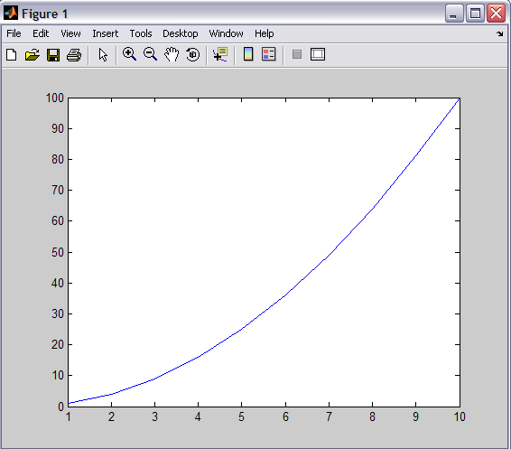
Simple Plotting
>> x=[1:10]; y=x.^2;
>> plot(x,y)
>> plot(x,y,'--')
>> plot(x,y,‘r-')
>> plot(x,t,‘o')
Specify simple line types, colours, or symbols
Use the help command to get guidance on using another command or function
>> help plot

Slide 52
By default any plotting command replaces any existing lines plotted in current figure.
hold command ‘holds’ the current plotting axes so that subsequent plotting commands add to the existing figure instead of replacing content.

